Slide 1
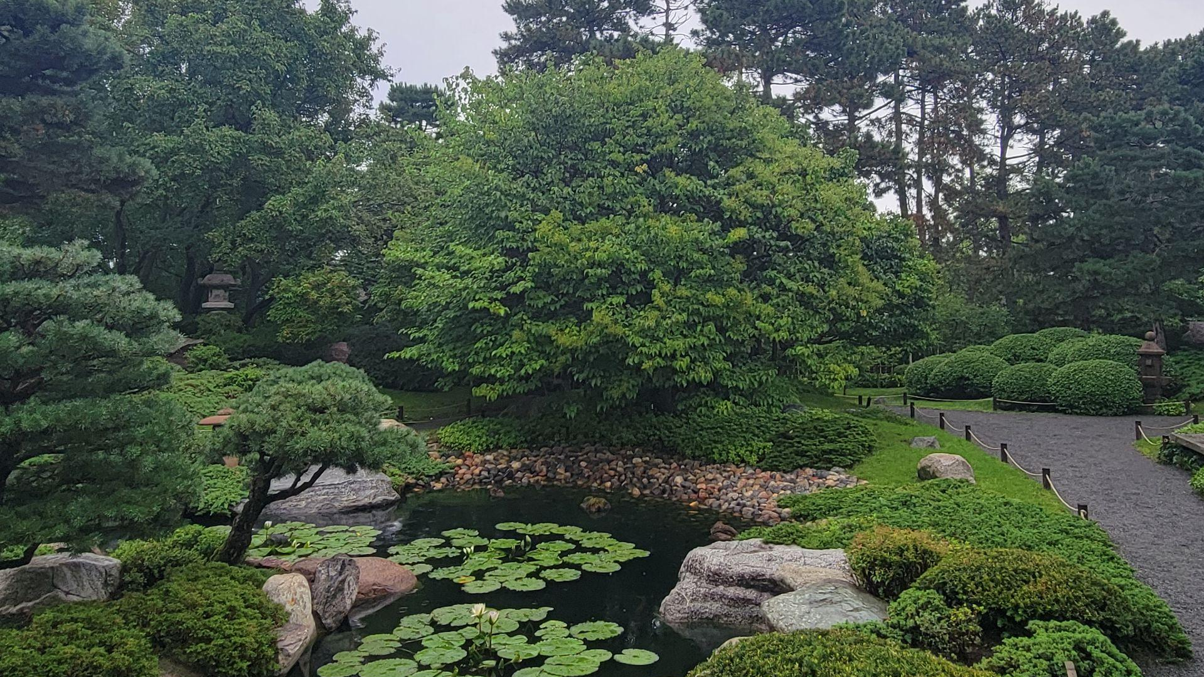
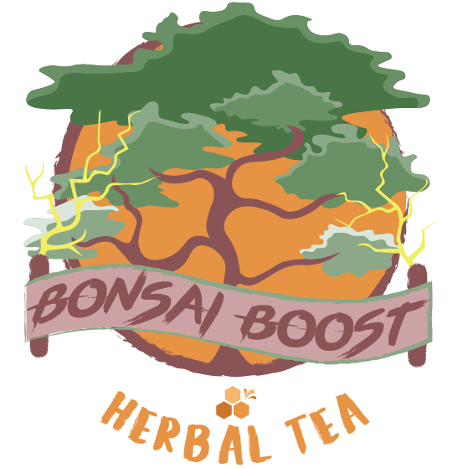
Brand Document
Cameron Smith
MKT250
10/27/2024

Slide 2
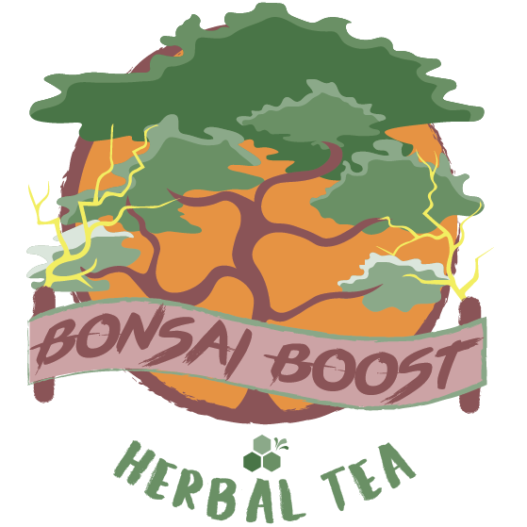
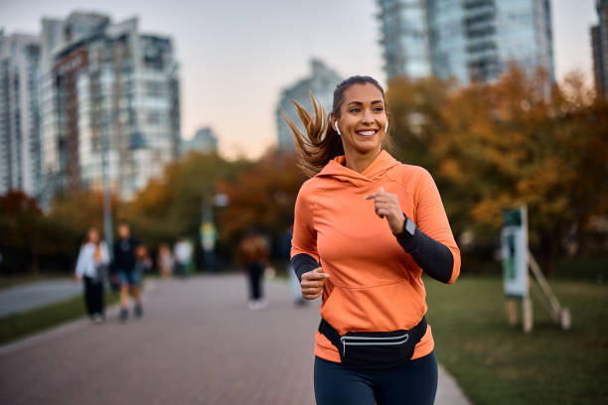
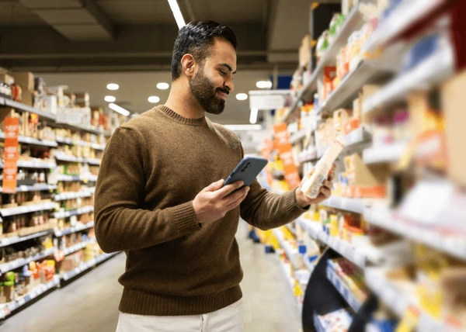
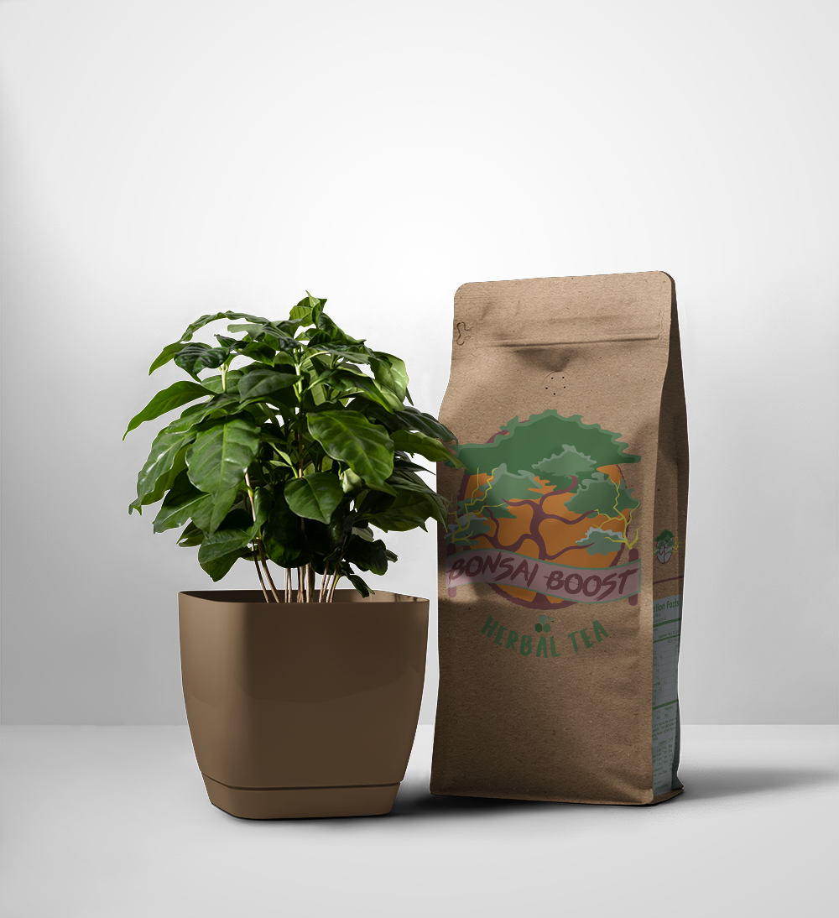
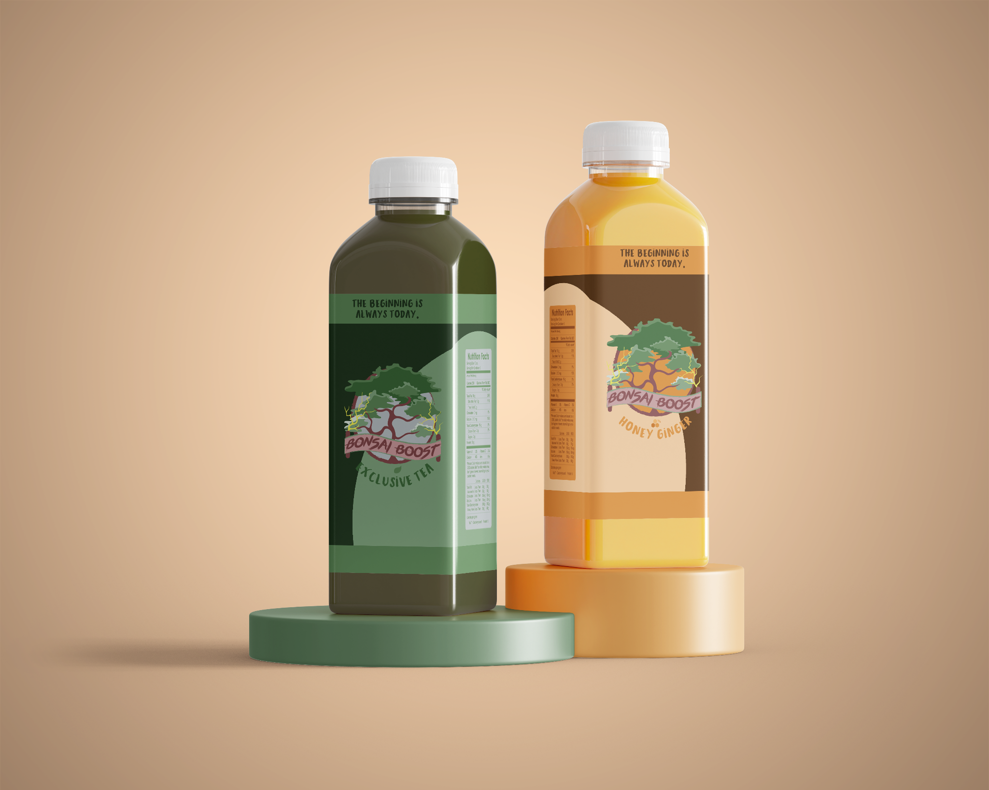
Bonsai Boost Brand Brief
Our Mission
Bonsai Boost was conceptualized as a higher caffeine energy drink that is composed of natural ingredients. Our mission is to encourage our consumer base to shift to a healthier and more natural caffeine consumption habit.
Primary Target Audience
Secondary Target Audience
Attributes
Committed: We are committed to providing our customers with the best quality product possible.
Reliable: We are a reliable brand that will always provide a product free of any unnecessary bloat ingredients.
Community-Driven: We encourage our customers to send feedback so they are getting their money’s worth.
Our primary target audience will be tea enjoyers that seek healthier food and drink options. Our product provides many health benefits and we believe that this will be the best approach to advertising and marketing.
Our secondary target audience will be teenagers and convenient store customers. If someone is looking for a refreshing drink, Bonsai Boost will catch their eye.

Slide 3

Survey Results
While conducting my Survey, I chose to ask questions pertaining to the quality of my product. I figured this would be useful to gauge my target audience more accurately and their desires from my brand. My findings are posted on the next slide.

Slide 4
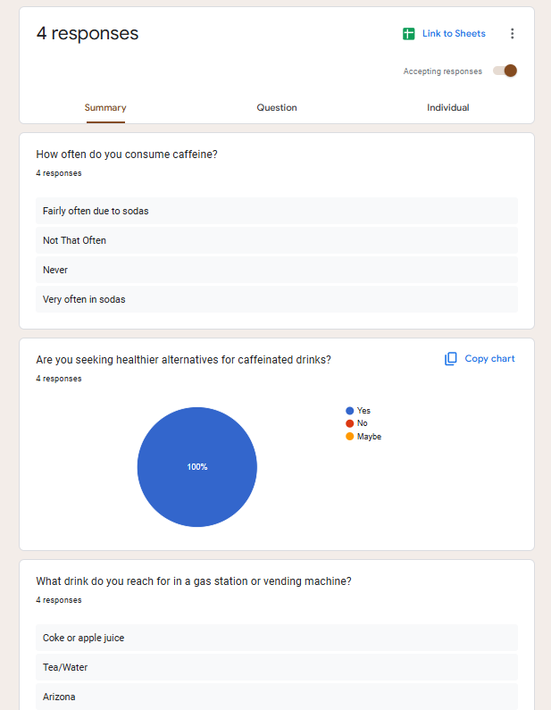
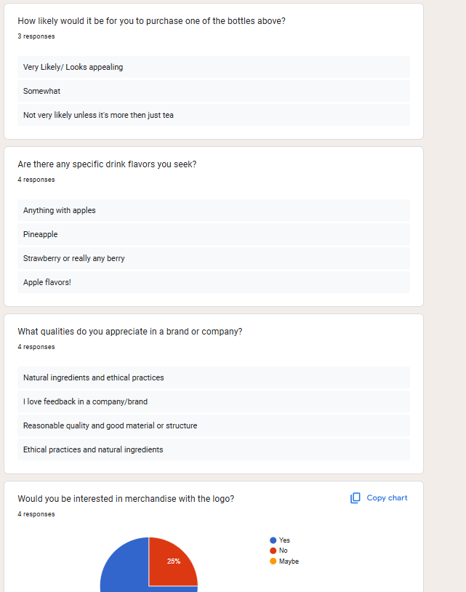
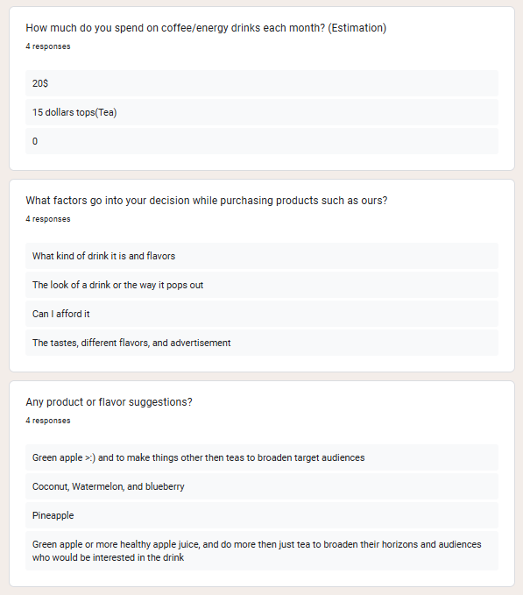

Slide 5
Cont.
Guayaki Yerba Mate
https://guayaki.com/pages/become-an-ambacebador
As for Guayaki, their website is easy to navigate and has a decently intuitive design. The main page has 3 drop-down menus that lead the customer to an assortment of things. The main goal of the website is to encourage their customers to find a store where they carry their product. They also do exclusive product deals for their customers and offer subscriptions, so online shopping is also heavily encouraged. However, the online purchase options are only in larger quantities. However, they are successful at building a sense of community and encouraging customers to join. I would say that there is still room for improvement in regards to their website though. Their typography choice doesn’t fully align with the stylization of the rest of the website and branding of the product itself. Overall, I think the flow of the site is still very strong and they are successful in engaging their customers and building a sense of community. I think that Guayaki has minimal changes to make and they will have an even better website.
V8 Energy
https://www.campbells.com/v8/v8-energy/?gad_source=1
I would say that V8/Campbell’s has the weakest website amongst the roster of competition I chose. All they do is describe their product’s flavors and effects. There is a severe lack of interaction from the visitor. The main goal of this website is to direct customers to a brick-and-mortar store where they can find their product. They don’t offer exclusive products or services on their website which makes their product placement much weaker. There are also occasional bugs when clicking the button that takes you to find a store near you that sells their product. Overall, I think this website could benefit from an overhaul or complete separation from the Campbell’s website. The website has decently intuitive design but does not keep the customer entertained. It sports a plain white look with a plain Arial-esque font. Overall, I think this website actually does a disservice to the product because of how bland the design is.
Brisk
https://www.drinkbrisk.com/index.html
Brisk has a very easy to navigate website with only the necessary information. They only have one small part of the website where they discuss their company mission and motives. The main goal of this website is to direct customers to nearby locations that carry their product. They only offer Instacart orders through the website. I would say that the strongest aspect of this website is their creative flair. It is very colorful, and eye-catching. Their design approach is bright and loud, and it works so well because they wear it shamelessly. Their typography choices are also very well-aligned with the energy of their brand. They also have animations on the website, which I actually think work in their favor. However, I do think that this website could benefit from a community tab where they interact with their customers on a closer basis. I think Brisk would become more of a household brand if they worked harder on their customer interaction. Overall, I still think Brisk has a strong foundation for their website. All they need is some more content.

Slide 6
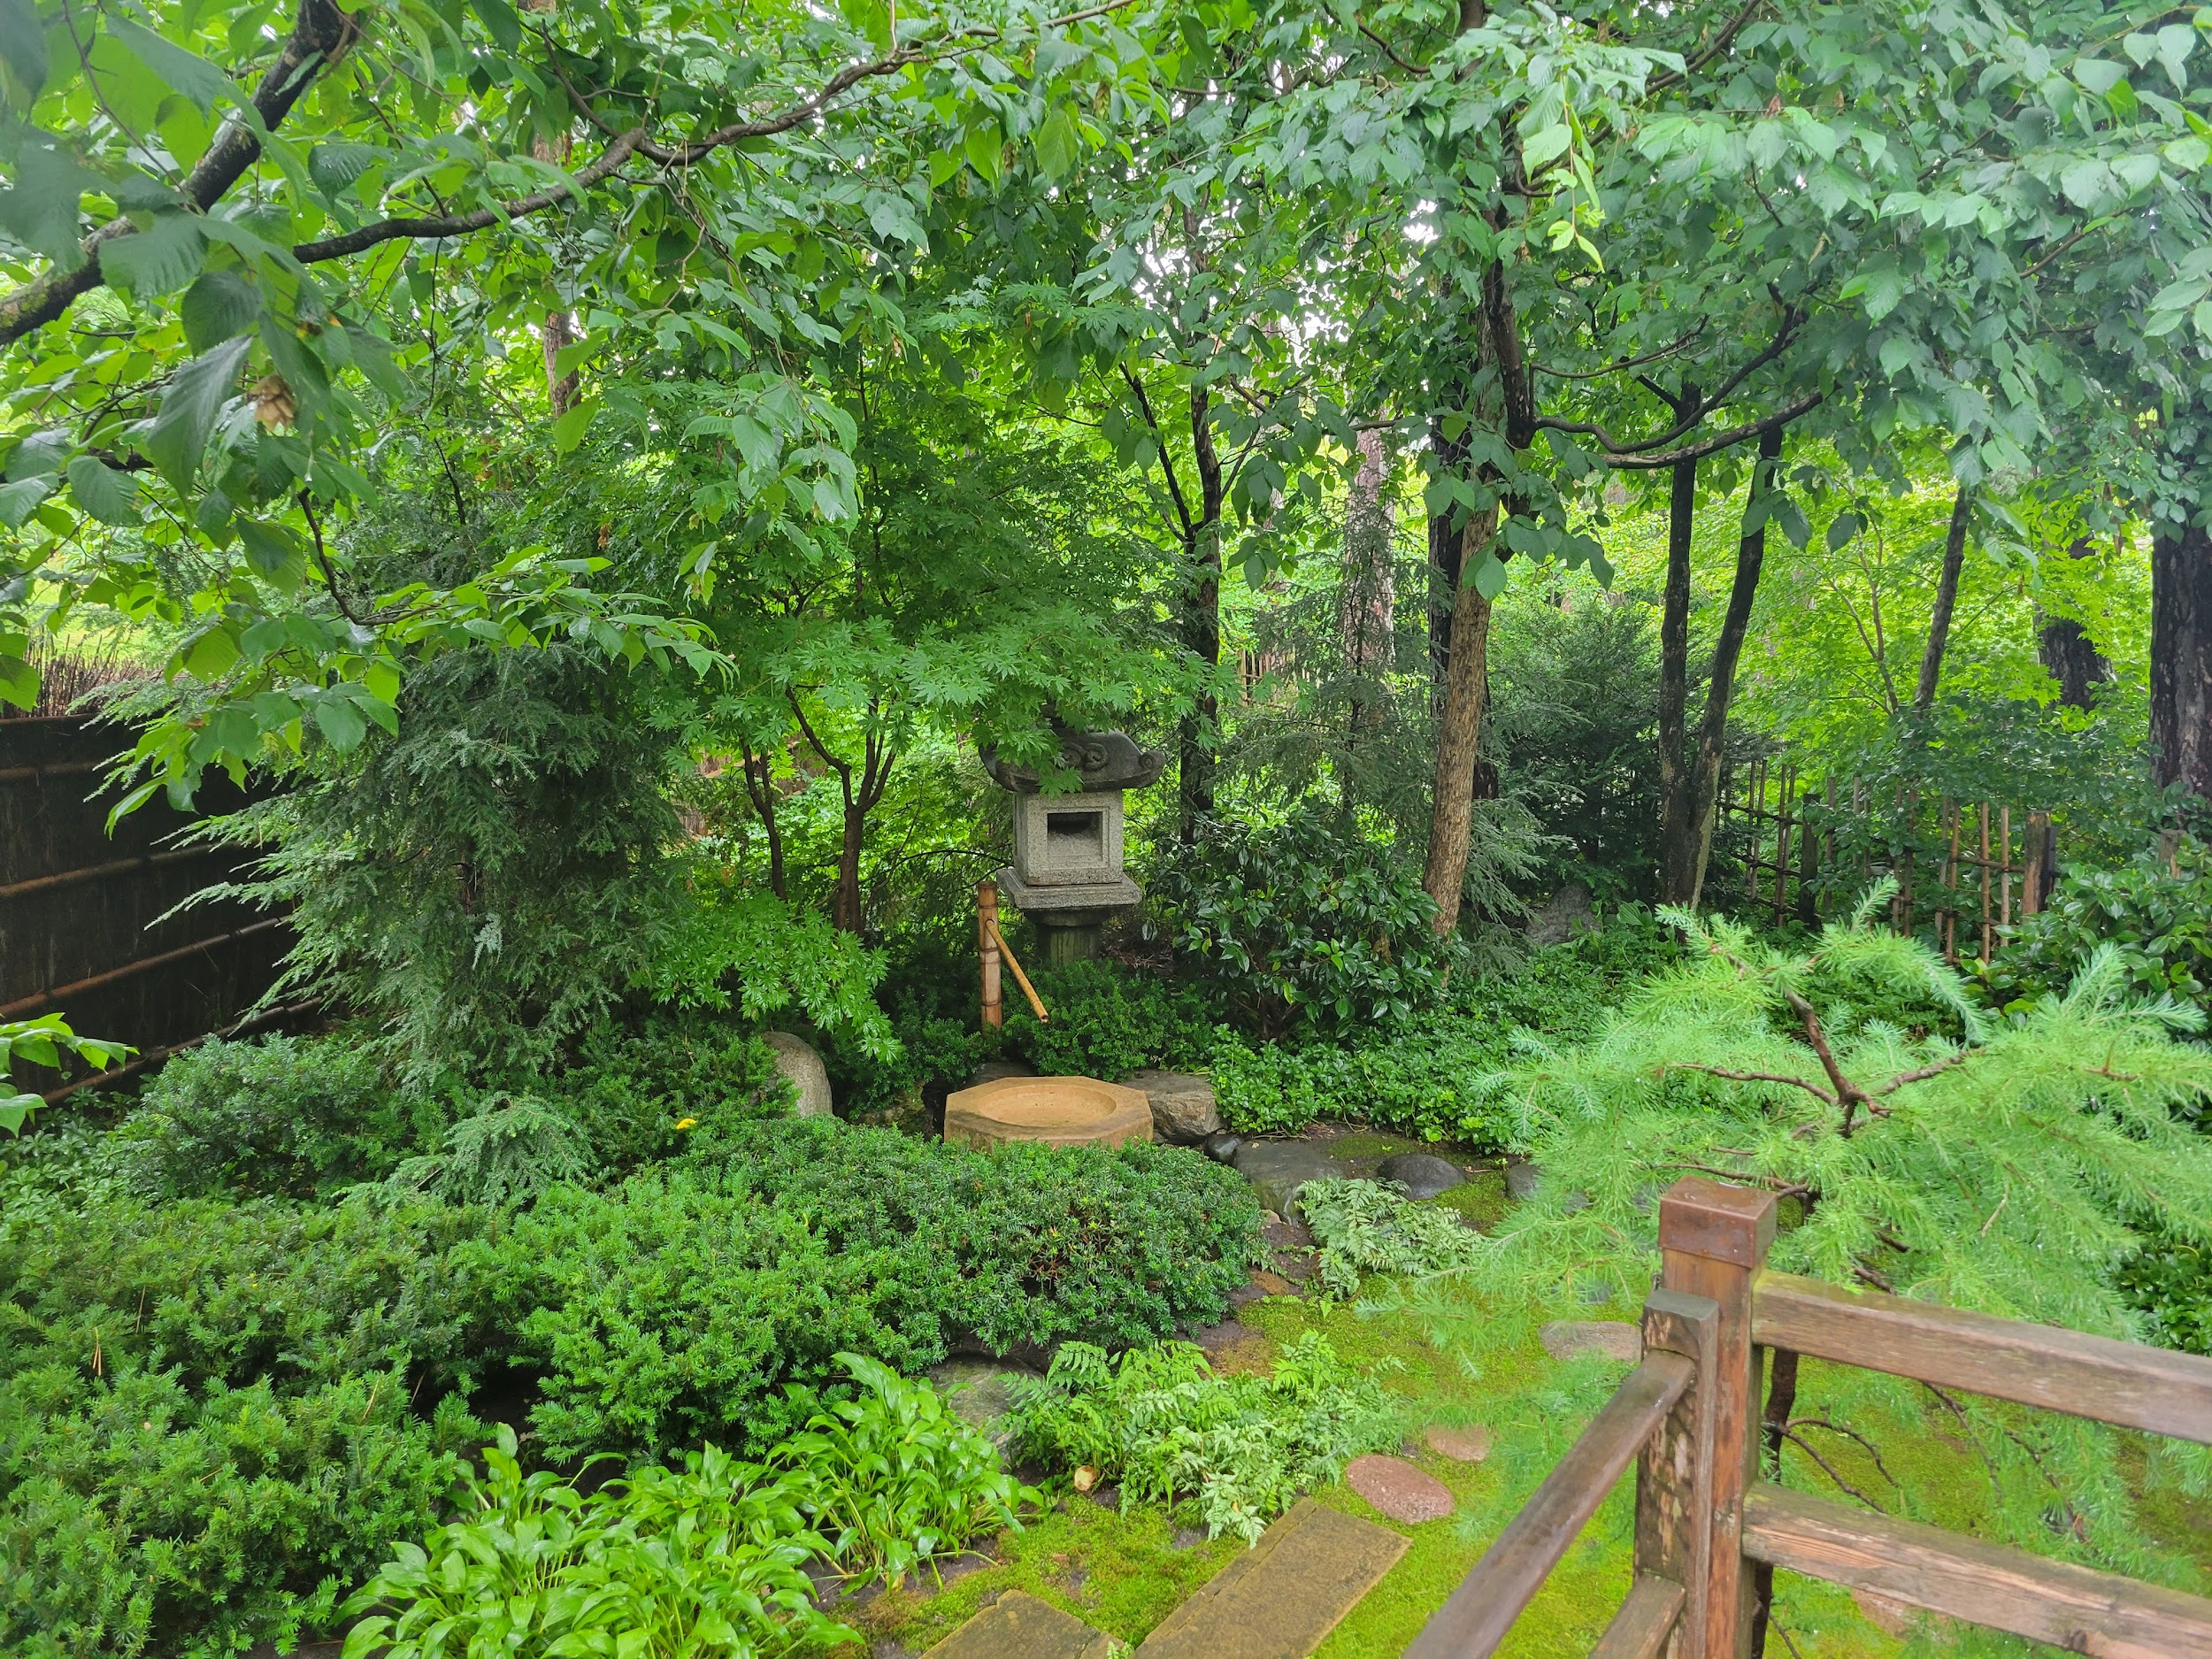
Logo Formation
COLOR: I chose the colors green, orange, brown, and yellow for the design of this logo. I found that all of these colors represent my brand and the product very well. They are natural colors and aren’t too vibrant, giving off the relaxing vibe that I was aiming for in the conceptualization stage. Green promotes feelings of calmness, health, and freshness. This aligns with my brand goal very well as the product I want to push is an herbal tea. Green also represents nature, so that’s an additional bonus. As for orange, I found that this color is associated with happiness, success, and passion. Similar to green, brown is associated with nature. In America, brown also conveys feelings of sustainability and dependability, meaning that people might be more likely to pick up a can or bottle of tea with these colors. Lastly, yellow represents energy, happiness, and productivity. This works well in my favor due to the fact that tea has naturally occurring caffeine.
TYPOGRAPHY: I chose the fonts Tropica Asian and Brushstrike because of the brush/hand-drawn stylization I was going for. It felt very synergetic with the style of the logo I already designed. For my brand’s online presence, I will probably use a more legible font like a simple rounded font.
PRESENTATION: I believe that the use of sound, animation, and more interactive features increases community engagement tenfold. When a customer sees that a company took time and put in a lot of effort into their product and presentation, they are more willing to support the business behind it. I don’t think these additions will take away from my logo specifically because it is fairly simple. I do think overuse will oversaturate the website and become too distracting, but if it is done in moderation, it will be very successful.

Slide 7
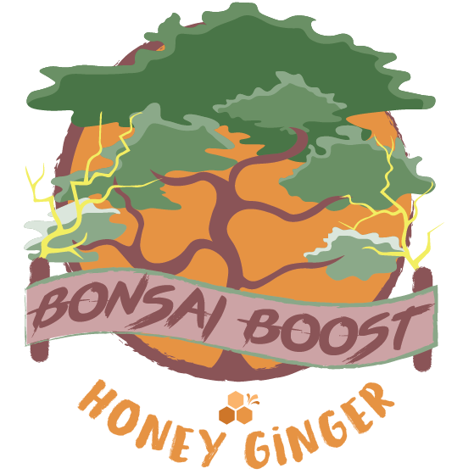
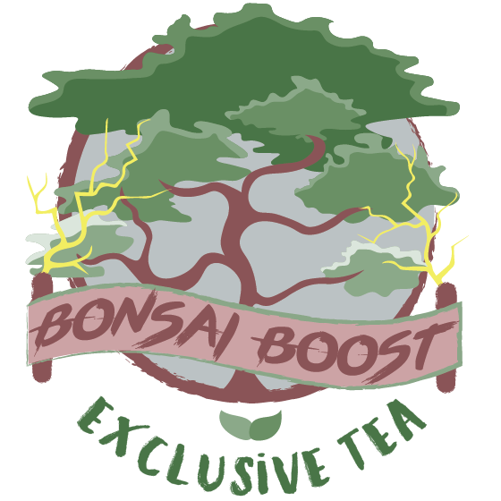
Logo & Flavors

Slide 8
Advertisement Campaign
Setting up advertisements for demographics and upcoming national events was relatively easy considering it is so close to halloween. Also, Bonsai Boost is branded as a refreshing drink so it is easy to target Arizona residents for marketing due to weather fluctuation.

Slide 9
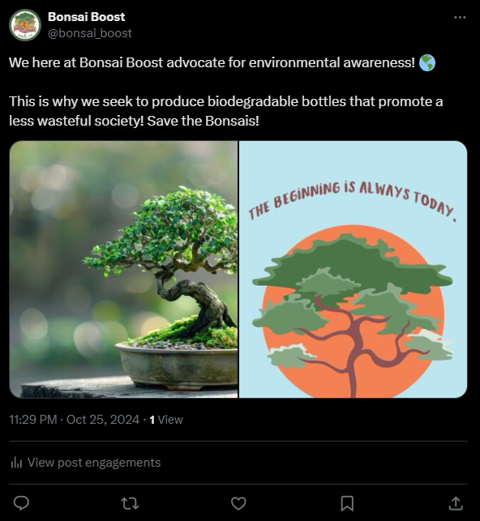
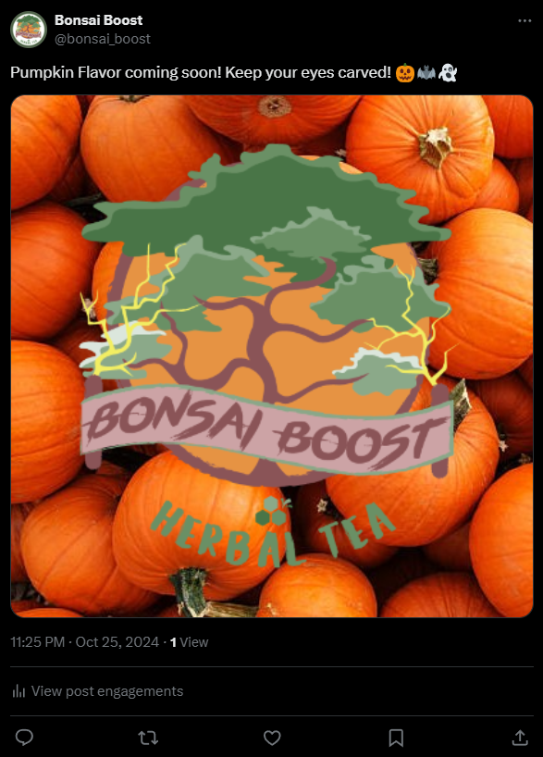
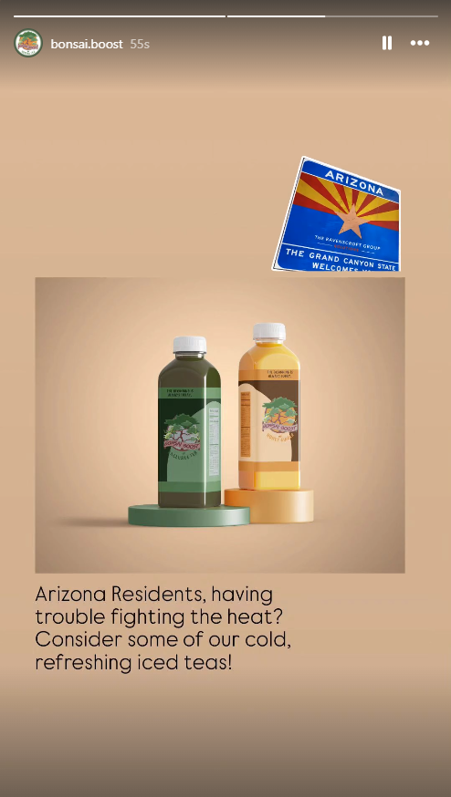
Advertisement Examples

Slide 10
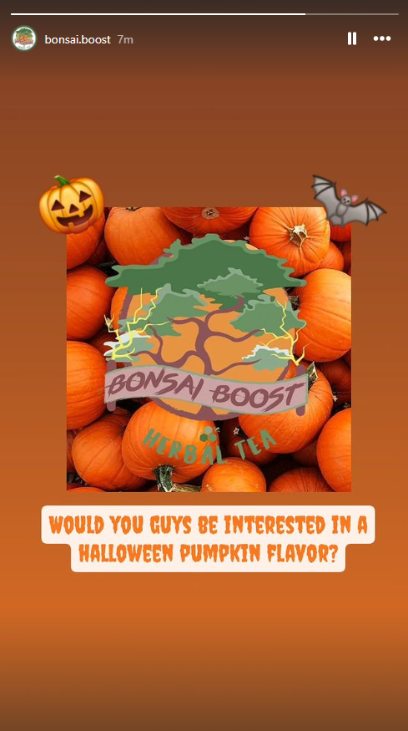
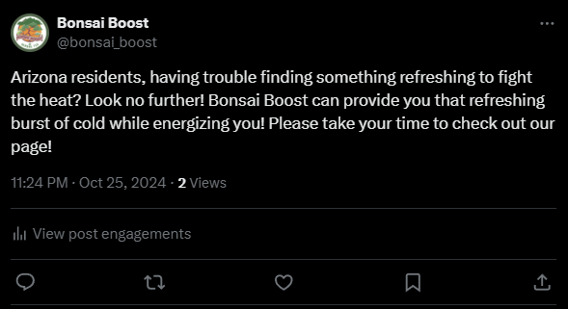
Cont.

Slide 11
Competition Analysis
While researching my competition, I analyzed 5 of my potential biggest competitors. Here are my findings.

Slide 12
AriZona
https://drinkarizona.com/
I think that AriZona Tea might be the strongest competition on this list due to their strong merchandise and advertisements. AriZona has always had a strong aesthetic, and this is seen as soon as you open the website. The main goal of this website is to sell their products. They offer a more unique and broad selection on the website than you would find in a physical store. They have branding everywhere that looks aesthetically pleasing. It is clear that an artist had a strong influence on this website. On the website, they sell their teas, juices, energy drinks, coffees, snacks, mixes, and clothing. This is a very wide array of items that only increases the amount of customers they can reach. The flow of the website is very strong and they have a seasonal ad on the front page that occasionally switches out. The merchandise and rest of the website’s branding definitely builds a stronger sense of community as well. If you scroll down, they offer email subscriptions where they can interact further with their audience and committed customers. Their ‘About Us’ section is concise and to the point and doesn’t keep the customer lingering too long. In this, they talk about their community in high regard and continue to strengthen their brand. Overall, I would say that this website is very strong and has a great flow to it. The design is intuitive and easy to navigate, and conveys information with the right amount of detail.
Pure Leaf
https://www.pureleaf.com/
Pure Leaf’s website is also a very strong contender for competition. The front page looks very aesthetically pleasing where they showcase their several different events and sweepstakes they are holding. Once you scroll down, you see videos with text over them. The videos consist of nature to further push to the consumer base that their product is fully natural. I think this is strong subconscious marketing that goes unnoticed. Scrolling down more, you see an assortment of all of their flavors for viewing. Under this, they even offer recipes for their tea flavors. I think this is very strong marketing because it is showing that they put trust in their customers. Navigating to their “Our Story” tab, they offer several different readable pages on their site. A lot of them are educational and illustrate their origins. They also have a second part to their “Our Story” that talks about their eco-friendly mission. They go into detail about their farming practices and they advocate strongly for rainforest preservation. Pure Leaf knows their audience and they designed their website around it. The main goal of this website is to make online sales but they also provide information to people who want to find a physical store that carries their product near them. Overall, the flow of the website is very strong and I think that something like this would be my approach when it comes to designing a website for Bonsai Boost.

Slide 13
Paid Search Campaign
Keywords & Phrases
Tea - $1.39 CPC
Energy - $3.87 CPC
Energizing - $0.97 CPC
Boost - $1.71 CPC
Soothing - $0.32 CPC
Mellow - $0.81 CPC
Herbal - $1.28 CPC
Fruity - $0.75 CPC
Crisp - $1.94 CPC
Focus - $0.54
Clear-Headed - $N/A CPC
Environmentalist - $4.94 CPC
Eco-Friendly - $N/A CPC
Energy Drink Substitution - $0.01 CPC
Bonsai Boost - Mellow Herbal Energizing Tea
Crack open a bottle of our eco-friendly energy drink substitution, Bonsai Boost! There are 3 flavors and more coming!
I think that this combination of keywords & key phrases is optimal for return on investment. I think the verbage would attract some browsing traffic and hit my target audience of people seeking healthier food and drink. I also think it would attract one of my other target audiences, environmentalists. I believe this strategy would also promote the business to future potential partners and expand my professional network as the brand head for Bonsai Boost.

Slide 14
Search Engine Optimization
Bonsai Boost Our Mission
Homepage
Contact Information
Refreshments
Community Events
Our Journey
While researching Search Engine Optimization, I found that keeping the verbiage on the navigation tools simple while still adding a flair of personality is key to optimizing search results with advertisements. I referenced other brand’s websites and came to this conclusion for the SEO keywords.

Slide 15
Content Marketing
Target Audiences
Health Enthusiasts
Healthy food options have become a more common thing for people to seek for in stores due to the internet and the phone. This is because ingredients can be more thoroughly researched and customers have gained more power over their purchases in later years. We even see people on platforms such as TikTok and Instagram making brand deals with organic or healthier substitutions for American food and drink staples. Due to this publicity, it will be easier to market Bonsai Boost.
Health enthusiasts and those who seek more natural ingredients are proven to be willing to spend more money on a product if it means they are receiving a higher quality product. This is why this specific demographic is my target audience with sales.
Environmental Activists
Environmental Activism has become much more “trendy” amongst younger generations. We have seen sustainable companies gain more online traction and user interaction since the conception of social media. Content marketing and demographic-focused advertisements are proven to work in favor of a lot of environmentally aware companies and brands since.
Similar to health enthusiasts, environmental activists are more likely to contribute money to a company that has ethical business practices and promotes ecological awareness.

Slide 16
Office Workers
Office workers are a big backbone behind the sales of disposable energy drinks. If an office worker is in a pinch, they would reach for a Redbull or Monster for a quick caffeine fix. Due to there being younger generations making their way into this line of work, advertising an eco-friendly healthy alternative energy drink at this time would work extremely well. This is because we are seeing an influx of Millenials and Gen-Z individuals entering these lines of work, who are statistically more likely to be more aware of their carbon footprint.
The backend of the marketing push is based on the tea having higher caffeine levels. Marketing a product to people who tend to use caffeine more than the average individual would increase ROI on advertisements and improve sales entirely. The average age of office workers in America range from 38-55 years old. This audience would be the perfect demographic considering that average coffee drinkers tend to be in the same age range. Offering a more natural tasting drink instead of something such as a Monster or Rockstar might be more enticing for this demographic.
Convenient Store Customers
Convenient store customers come from all backgrounds and it is hard to pinpoint a certain marketing technique. The best bet is advertising the convenience of our product.
This is my last target audience due to the fact that there is no influence on purchasing the product besides convenience or a dedicated customer. Advertising this as a convenient product will increase general sales and brand awareness.

